Slide 1
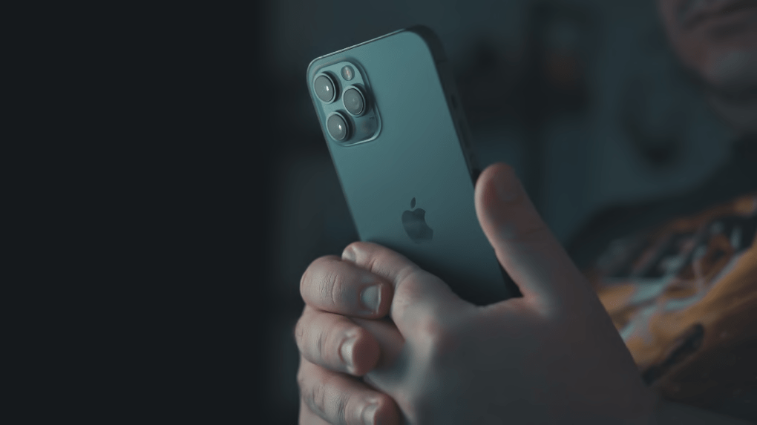

Telecom
Bil ing System
Sufyan Azeem
FA20-BSE-112

Slide 2



Project Requirement
What Is Not Requirement?
Build A Project Of Your Own Choice.
Use At Least One Data Structure Of Your Own Choice.
Length Of Code.
Any Specific Functionality.
Sufyan Azeem
FA20-BSE-112

Slide 3
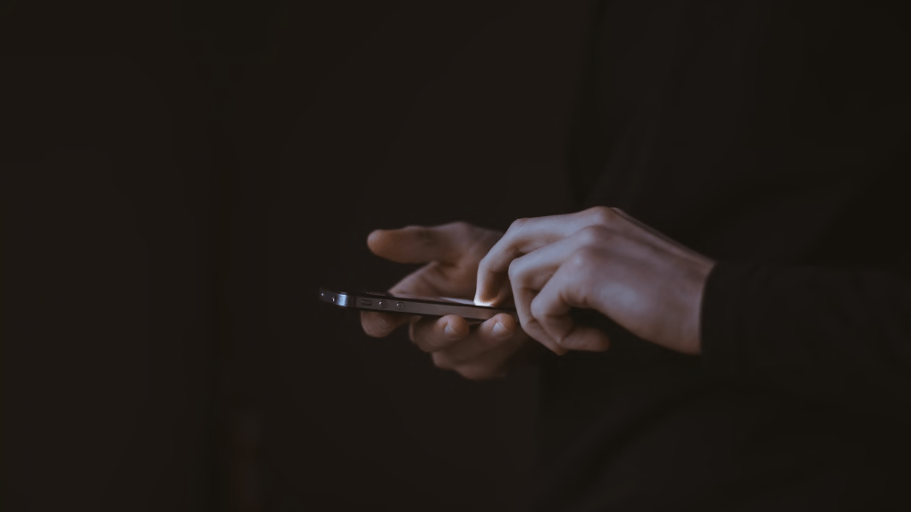


Motivation
The growth of the telecom industry has been faced with a
lot of challenges until recently when it gave rise to the need for an efficient billing solution. However, it is during previous few years that billing system has received significance equivalent to other aspects of the telecom sector.
The billing process is a complex one and must be done in an accurate manner that’s why every telecom company must understand the significance of high accuracy in the entire billing process. Remember an error that can occur within a
minute can adversely affect the company financially.
Sufyan Azeem FA20-BSE-112
Vigorous billing software certifies that final bill received by
users is error-free.

Slide 4


Data Structure
Linked List
Sufyan Azeem
FA20-BSE-112

Slide 5

Functions
Admin Panel
Insert
Update
Delete
Search
Display
The functions which are used in my program to perform different operations.
Customer Panel
Check Bill
Pay Bill
Sufyan Azeem
FA20-BSE-112

Slide 6

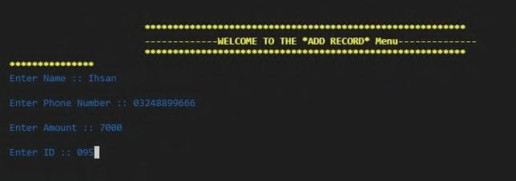
Demo
Insertion of
Data

Slide 7
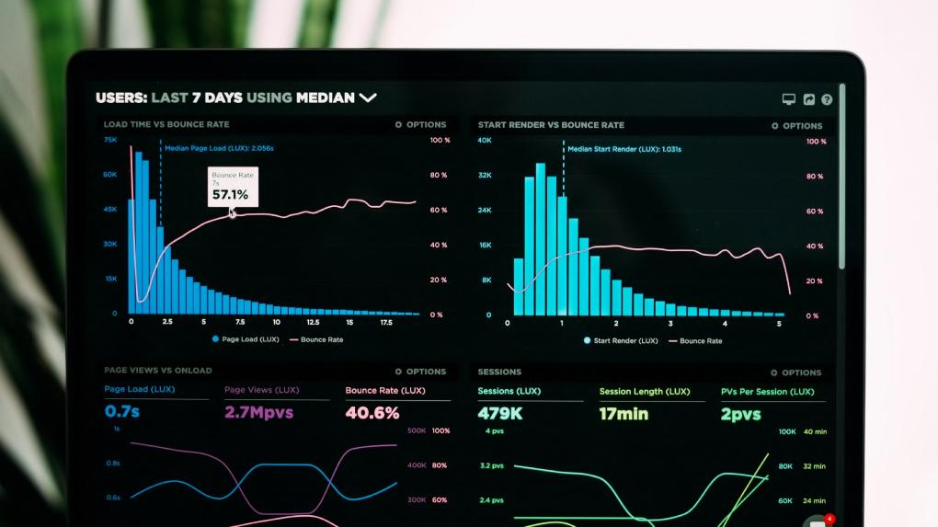
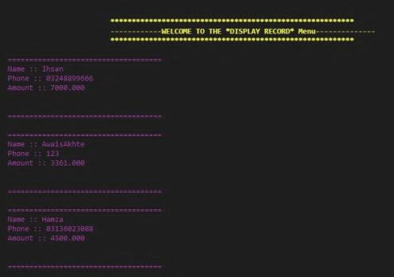
Demo
Displaying Data

Slide 8

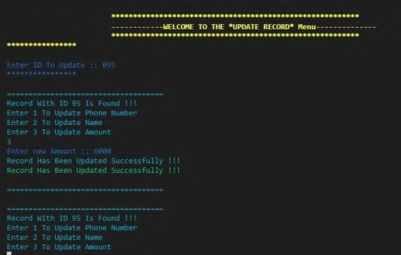
Demo
Updating Data

Slide 9

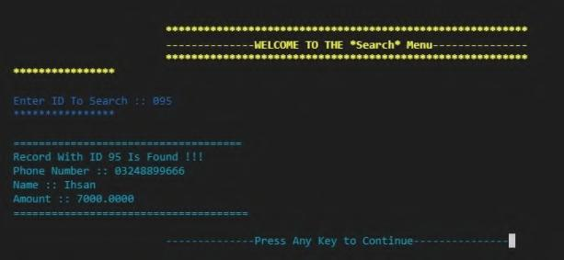

Demo
Searching Data

Slide 10

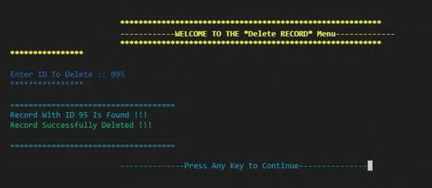
Demo
Deleting Data

Slide 11
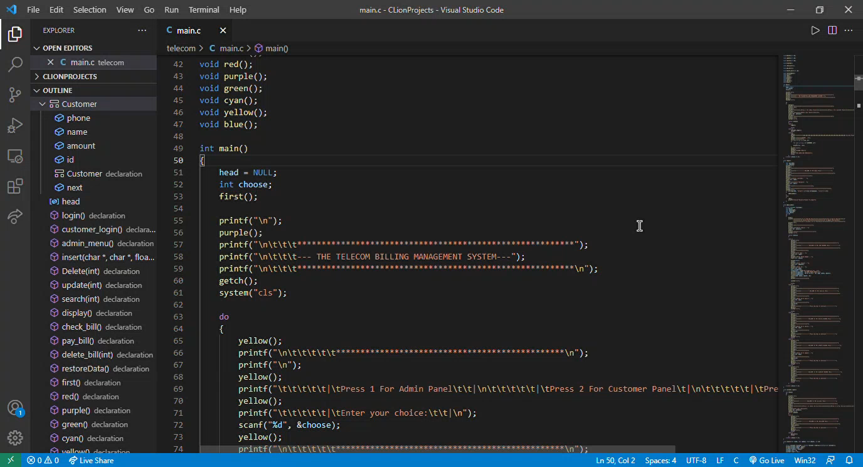
Project Demo Video

Slide 12

Thank You

